Slide 1

DEEP LEARNING FOR SYMBOLIC MATHEMATICS Lample, G., & Charton, F. (2019). Deep learning for symbolic mathematics. arXiv preprint arXiv:1912.01412.
Mehrazin Alizadeh
EECS 6322

Slide 2
Agenda
Problem Description
Dataset
Model Description
Results

Slide 3
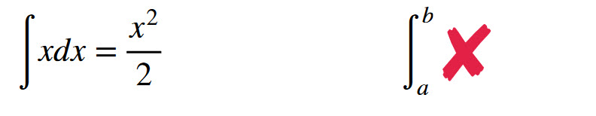
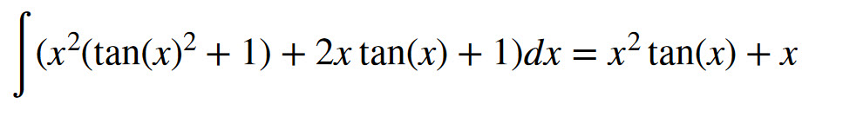
What is Symbolic Math?
Input sequence
Output sequence

Slide 4
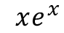
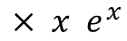
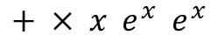
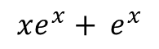
Proposed Solution
Seq2Seq model
Infix expression
prefix expression
prefix expression
Infix expression
Seq2Seq model
$$xe^{x}+ e^{x}$$
$$+ × x e^{x} e^{x}$$
$$× x e^{x}$$
$$xe^{x}$$
Seq2Seq model
(((x)*(exp(x)))+(exp(x)))
add mul x exp x exp x
mul x exp x
((x)*(exp(x)))

Slide 5
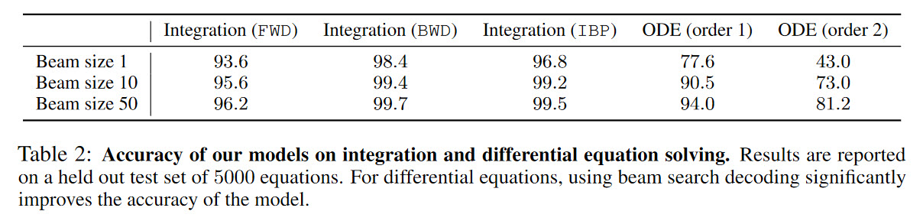
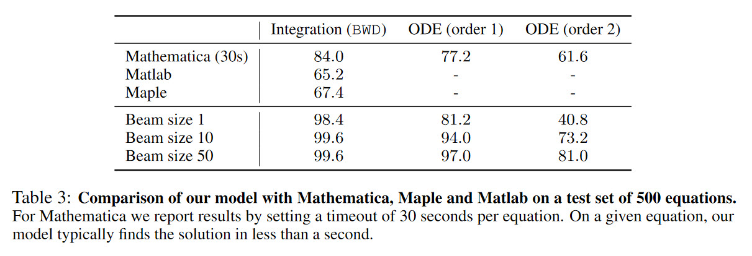
Scope of Reproducibility

Slide 6
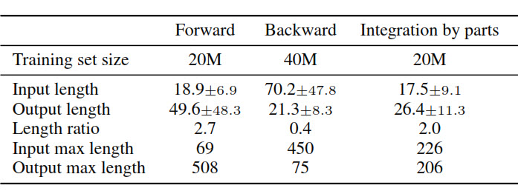
Dataset
Backward generation (BWD)
generates a random function f
Computes its derivative f’
adds the pair (f’, f) to the training set
long problems with short solutions
Example:
input:
sub Y' add mul INT- 1 mul pow x INT+ 2 pow add INT+ 1 x INT- 2 mul INT+ 2 mul x pow add INT+ 1 x INT- 1
output:
mul pow x INT+ 2 pow add INT+ 1 x INT- 1

Slide 7
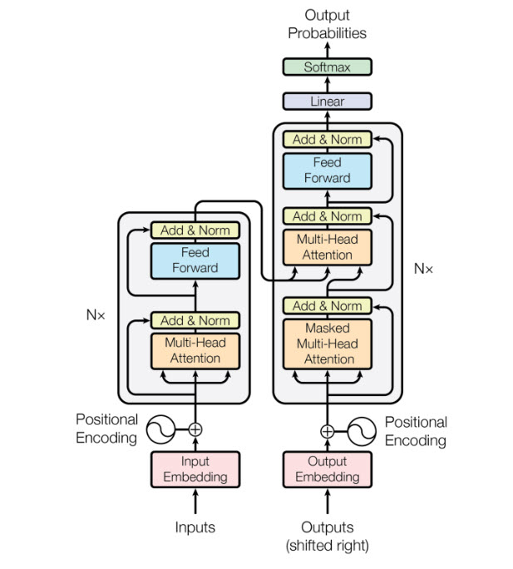
Model
Sequence to Sequence model: Transformer
Hyperparameters:
8 attention heads
6 layers encoder
6 layer decoder
Dimensionality 512
Adam optimizer
Learning rate 0.0001
Batch size 32 and 256

Slide 8
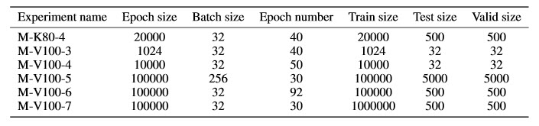
Results
Hardware:
Experimental Setup
Name | GPU | RAM | CPU | Storage
M-K80 | Nvidia K80 | 50 GB | 4 core | 100 HDD
M-V100 | Nvidia V100 | 13 GB | 2 core | 100 SSD

Slide 9
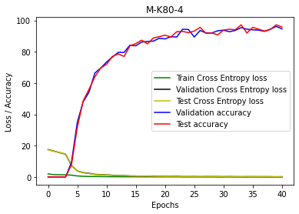
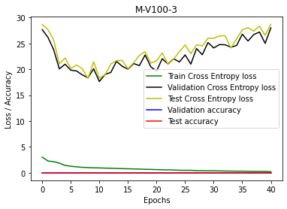
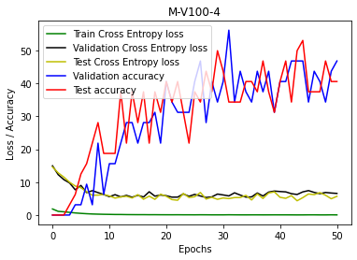
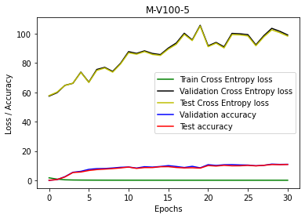
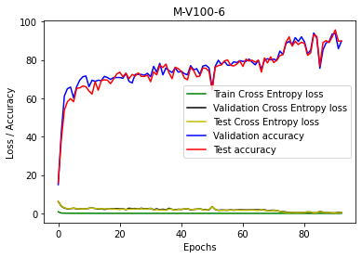
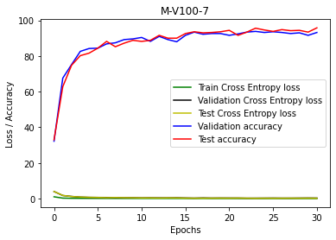
Results

Slide 10
Thanks

